Slide 1
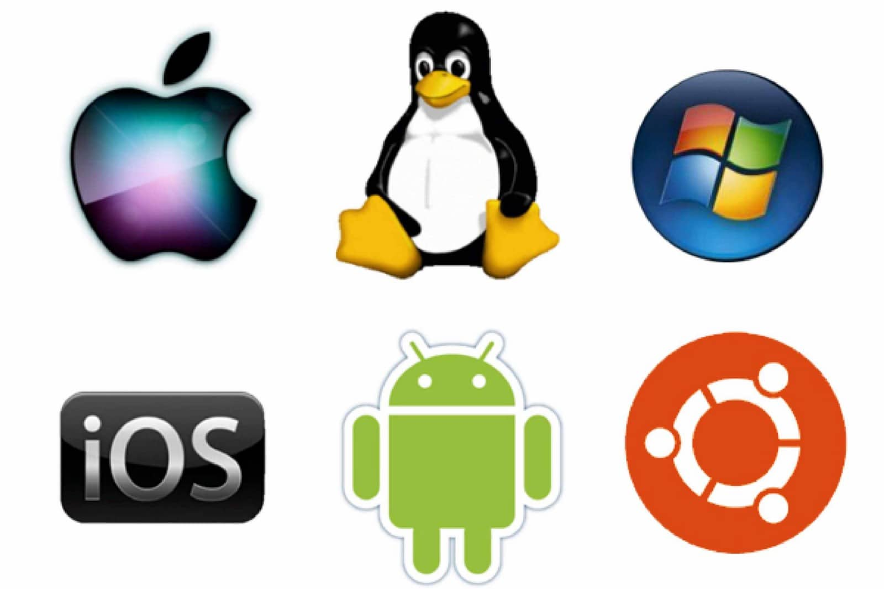
Opearting systems Pronin Arseny, IU7-32b

Slide 2
Presentation plan:
OS definition
The importance of OS
Most popular operating systems
The need for OS
OS functions

Slide 3
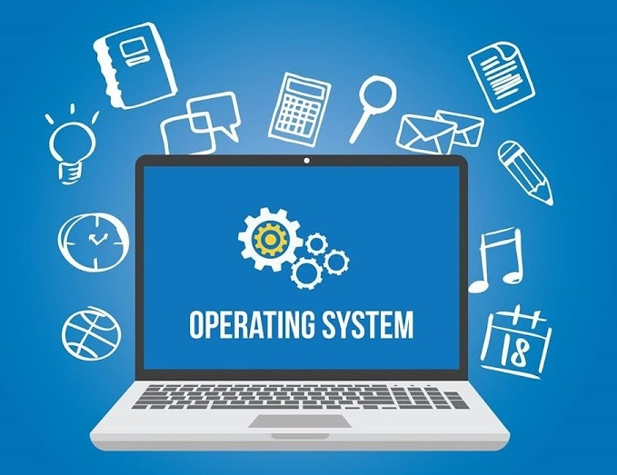
OS definition

Slide 4
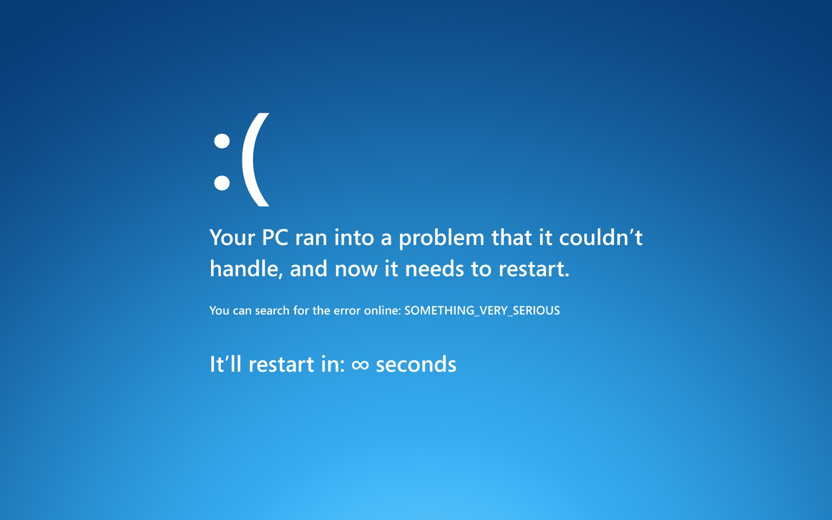
The importance of OS

Slide 5
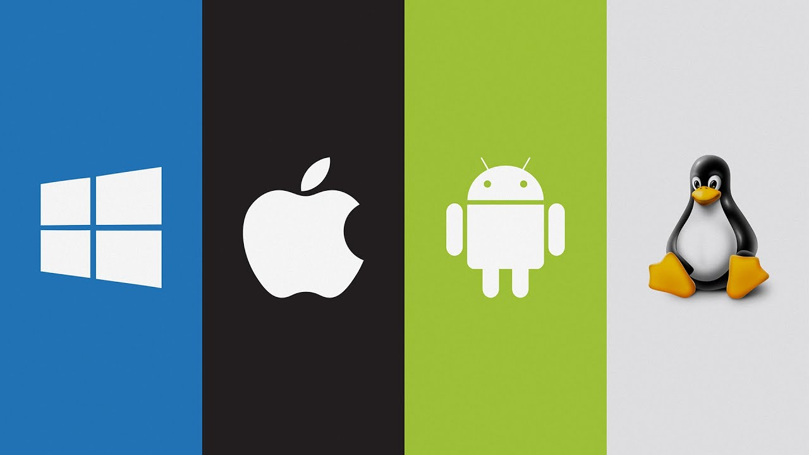
Most popular operating systems

Slide 6
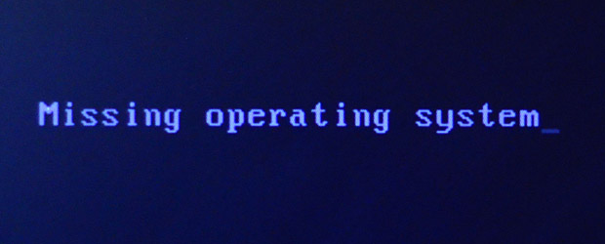
The need for OS

Slide 7
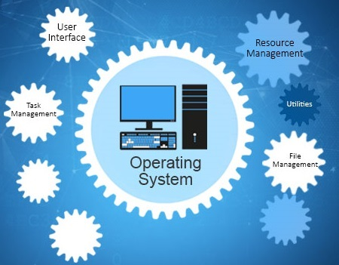
OS functions

Slide 8
Thank you for your attention!

